Slide 1

7 Reasons Why Your Business Needs a Mobile App
By: Anthony Nava

Slide 2
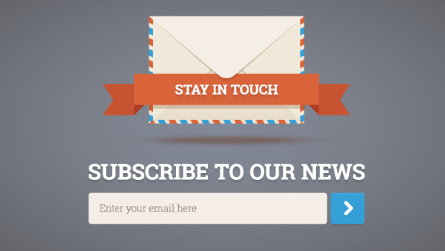
Be Visible to Customers at All Times
Why?
To be a successful business you don’t only need to have a great item but you also need to create a following and make sure that you keep them updated constantly on what you are up to so that way your brand doesn’t die off and your forgotten about.
How?
To accomplish this it is important that you have an accessible easy to surf functional website which gives consumers the option to sign up to receive texts, emails, or even notifications directly on your phone via an app.

Slide 3
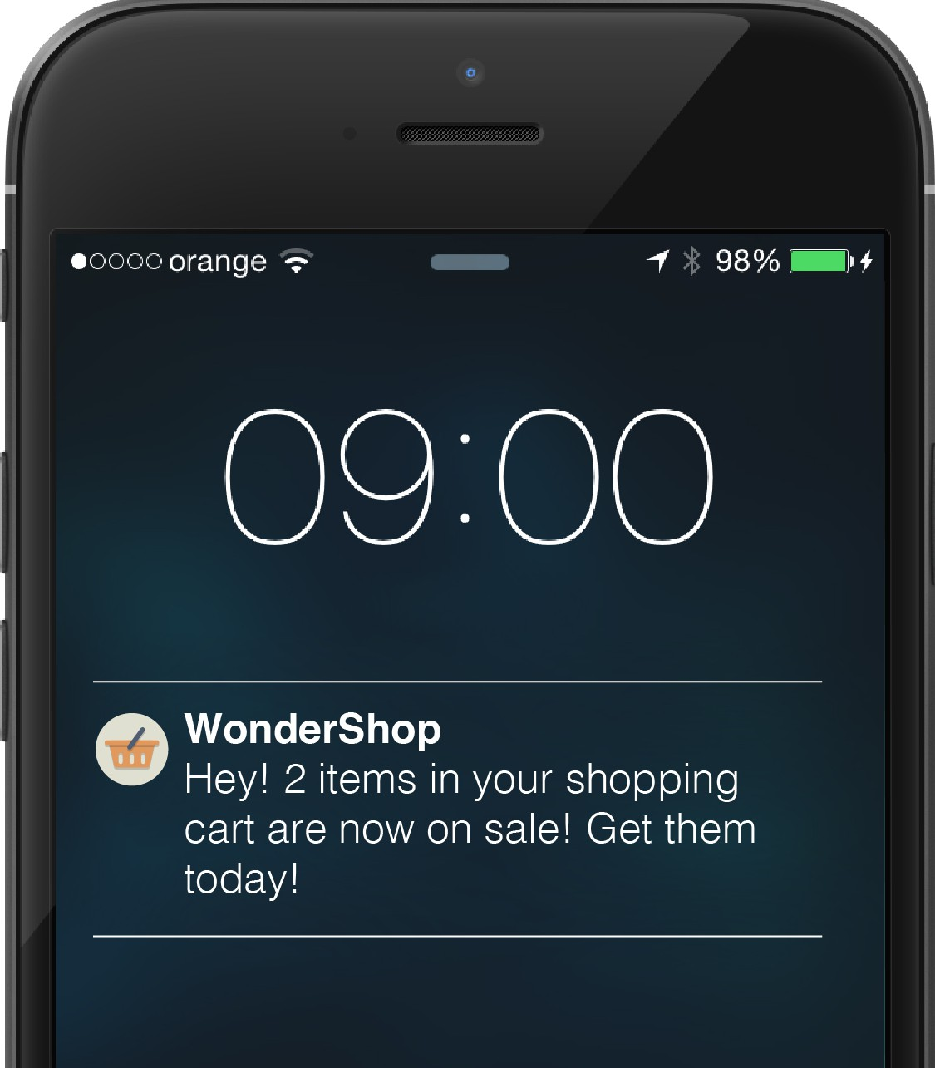
Create a Direct Marketing Channel
Why?
This allows for easy nearly instant access to various products of a brand through the use of apps on personal devices of the consumer and makes it so that way your not forgotten about and might even incentivize consumers to buy product.
How?
To accomplish this all you need to make sure is that you have an app which runs smoothly and maybe even offer an incentive to download the app and most importantly have notifications but ensure you avoid constant spam.

Slide 4
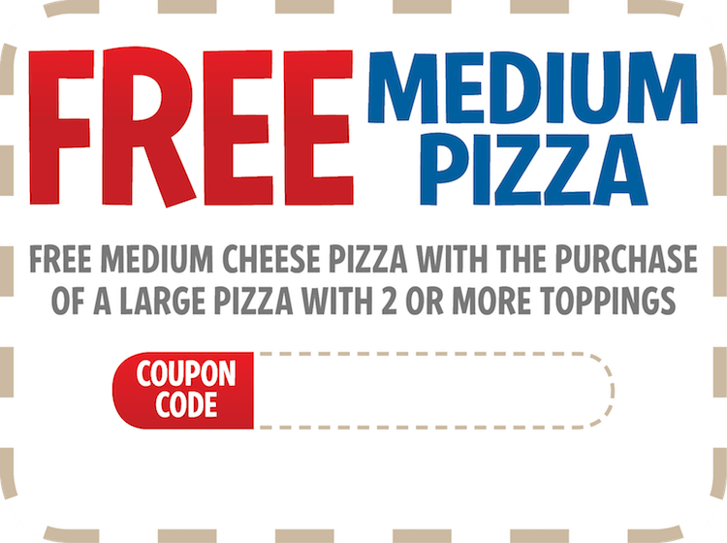
Provide Value to Your Customers
Why?
Giving benefits and rewards to your consumer is something that I believe is vital to keep the consumer actively involved and spending because it makes them feel great and a happy customer is more likely to spend then a not happy one.
How?
Offer daily or even monthly deals which gives consumers reduced prices on certain product or you can even do something like a rewards program which gives in store credit for each product bought.

Slide 5
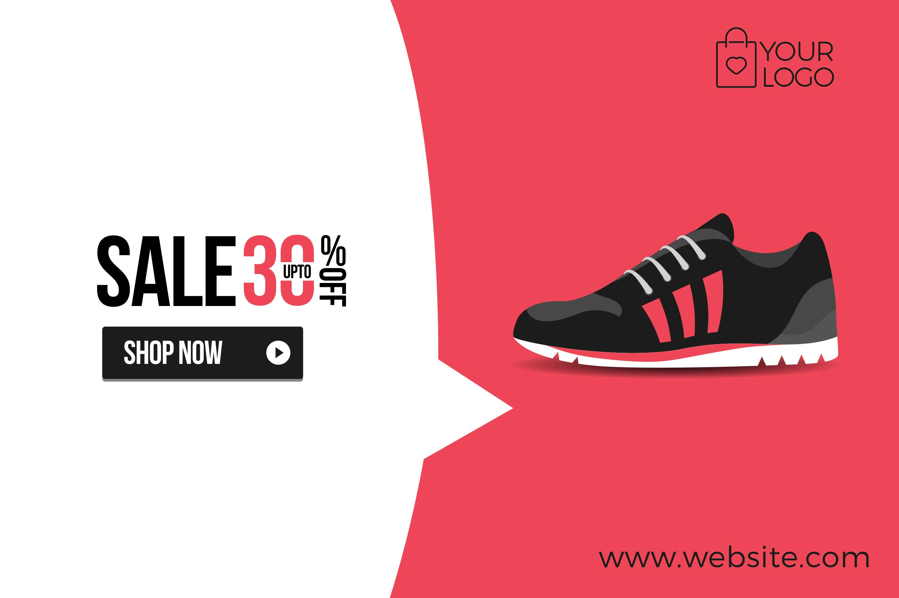
Build Brand and Recognition
Why?
Building recognition and building a following for your brand is one of the most important things when building a successful business because even if you have the most amazing product in the whole world if now one knows about it then you aren’t going to be making any money.
How?
Constantly market your product using the best strategy for your product which may vary because shoes aren’t going to be marketed the same way as McDonald’s.

Slide 6
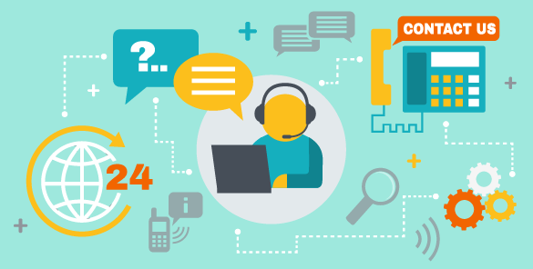
Improve Customer Engagement
Why?
Its important to give the customer options and make sure that the consumer is being put through a more enjoyable hassle free environment when buying your products and make sure they're getting proper help because if the consumer feels like they're doing more of a chore then shopping for fun they’ll be less inclined on spending
How?
Make sure that you have functional easy to find and accessible support for your product via text, call, etc. To ensure that the consumer will be able to properly receive help.

Slide 7


Stand Out From The Competition
Why?
This is essential because if your to similar to a product which is much more popular or affordable then your product then it is going to impact the reputation of your product and cause the product to die off.
How?
Have distinct features to your product which sets your product off from others this can be achieved by the look, pricing, or even marketing strategy of the product.

Slide 8
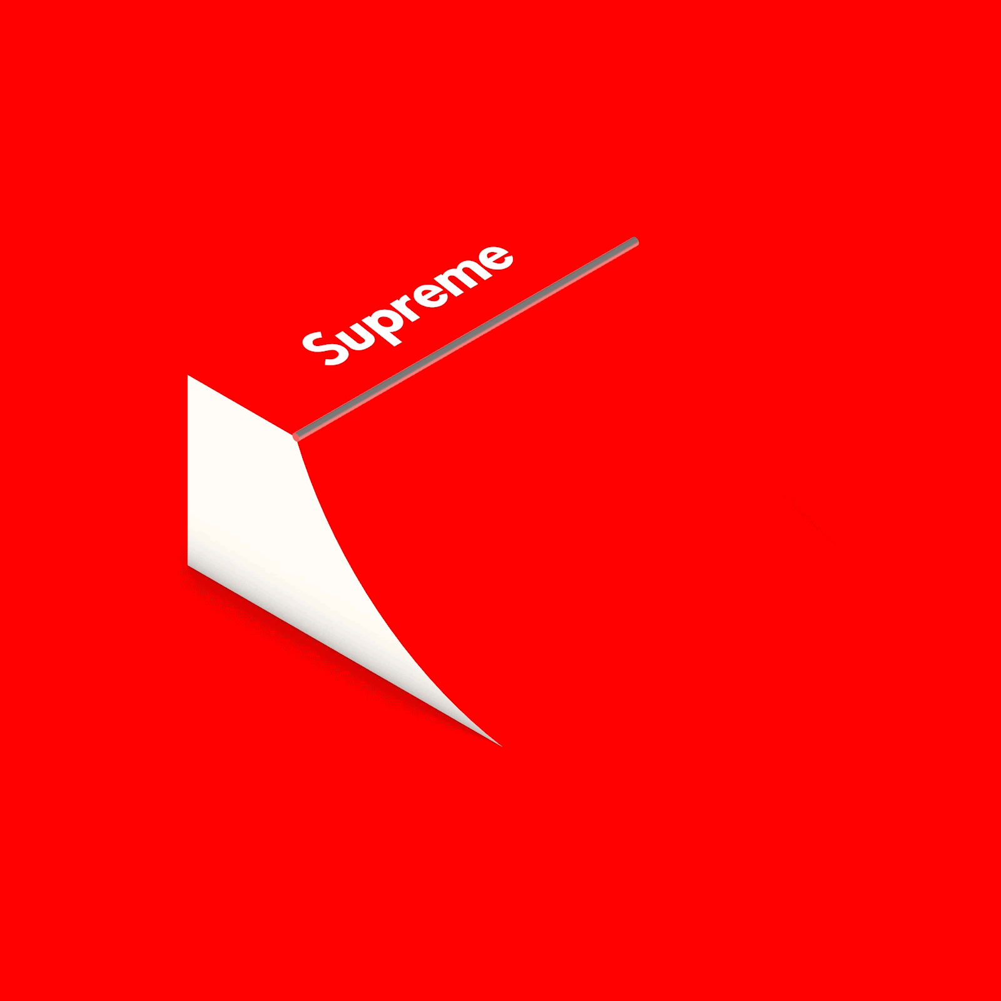
Cultivate Customer Loyalty
Why?
To create a large following you must first make sure that you have completed all the other steps that was just talked about and is important because having loyal customers raises awareness for your product and keeps it alive and safe from being overshadowed by other products.
How?
This can be done in a few different ways one being raising awareness through celebrities or even by targeting specific demographics using various marketing ads and giving your consumer a sense of pride by strengthening your brand image.

Slide 9
Done.

